Slide 1


Weekly Report: Internship Week 2
Rane Steering systems - R&D division
Presented by: Mohnish Raja • 06/06/2025

Slide 2
Task 1 - Extension Spring Design
Objective:
To design and validate an extension spring configuration used in the tilt mechanism of a manual steering column.

Slide 3
Design Problem - Existing
The extension spring is used to constraint the tilt movement of the steering column as the user intends.
Currently, when the driver unlocks the steering column in the tilt-down position, the column bounces up unintentionally. Analysis showed that the spring generates a significantly higher force (~65 N) than what is required (~8 N) at this position, causing this undesired motion.

Slide 4
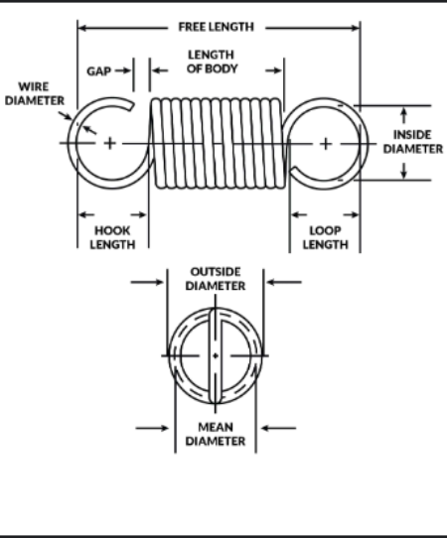
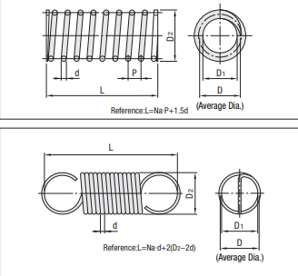
Schematics

Slide 5
Requirements & Constraints
Requirements
Spring force must be just greater than or equal to 8N in the tilt-down position.
The washer must have a life of 20,000 endurance cycles.
Constraints
The deflection and force by the spring in the tilt-down & tilt-up position must be less than the safe deflection and force.
Spring dimensions must be within packaging constraints of the tilt bracket assembly.

Slide 6
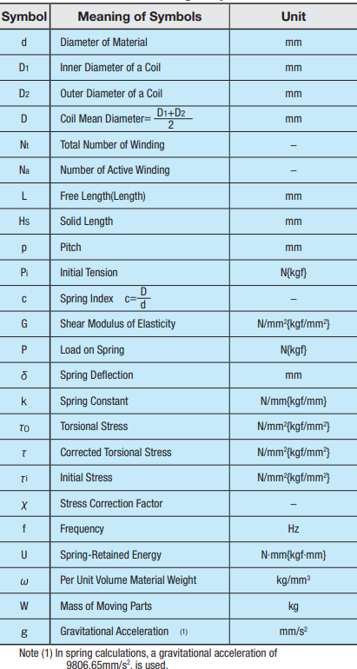

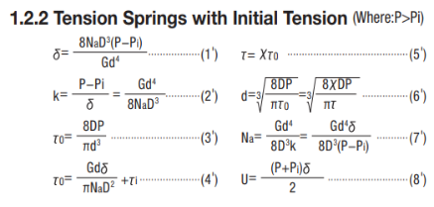
Governing Formulae

Slide 7
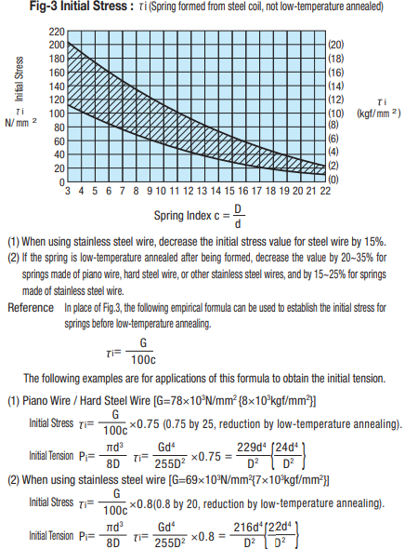
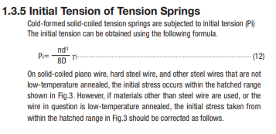
Governing Formulae

Slide 8
Solution Approach
Used customer-specified tilt actuation force and tilt force equations to back-calculate the required spring force.
Estimated the generated spring force using the known extension and calculated spring rate(stiffness). Since this force was observed to be much greater than the required force, the spring rate had to be reduced.
Modified material diameter, outer diameter by performing 8 iterations to reduce the spring rate and thereby the spring force.

Slide 9
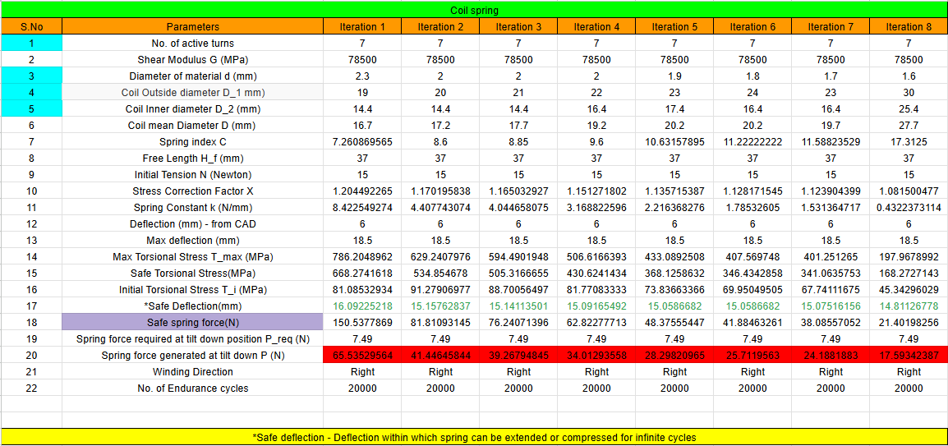
Final Output
Decreased Outer Diameter and increased Material Diameter to decrease the spring rate(stiffness).
Hence the spring force decreased for the same deflection.

Slide 10
Task 2 - Study of Design Workflow in R&D
Objective:
To understand the overall Research and Development (R&D) workflow followed in the design and development of steering columns at Rane Steering Systems.
Method:
Studied the company’s Quality Assurance System(QAS) chart and used it as a reference to create process flow diagrams in the Quality System Procedure(QSP) Chart.
Interacted with mentors to understand the flow between stages of the QAS chart.

Slide 11
Key Observations from the Workflow
The process is divided into clear stages:
Concept Design → Drawing Release → Prototyping → Testing & Validation → Release for Production.
Design iterations are validated through regular input from testing, manufacturing, and quality teams.
Decision / Feedback gates are placed at multiple points to ensure alignment with performance and customer requirements. Several Reviews are conducted to ensure that process flow is followed properly.

Slide 12
Learnings & Application
Learnings:
Understood how structured documentation and gated reviews reduce rework.
Learned how R&D decisions are aligned with timelines, testing feedback, feedback from different departments and customer expectations.
Application:
This understanding will guide how I structure my own tasks, document learnings, and seek feedback. It also helps in seeing how my work fits into the larger development pipeline.

Slide 13
Thank You!

